Slide 1
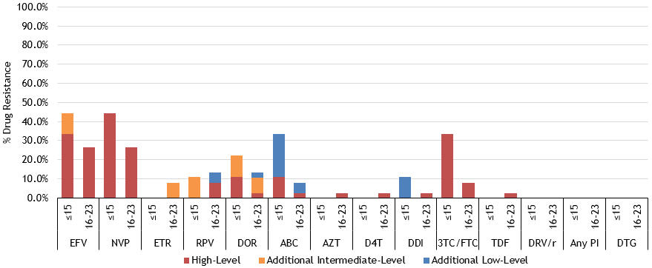
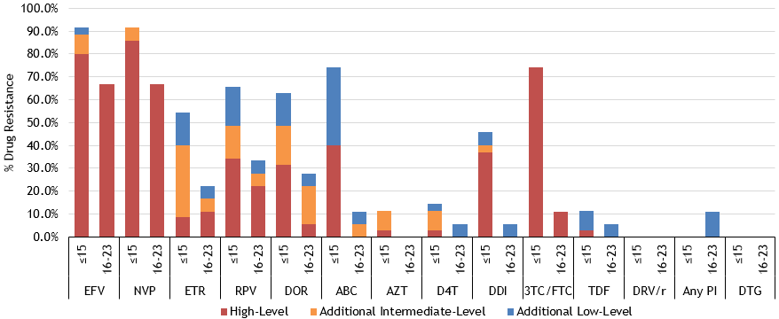
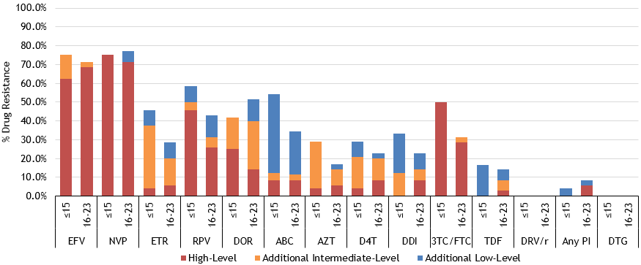
High Rates of NNRTI and NRTI Resistance in Children and Adolescents: Impact on Future Treatment Options Globally
Nadalette Alcenat¹, Lovely Cassandra Francois¹, Elsie Jean¹, Samuel Pierre¹, Gaetane Julmiste¹, Johnny Wu², Marie Elmaze Belizaire¹, Antoinette Clervil¹, Patrice Severe¹, Alexandra Apollon¹, Emelyne Dumont¹, Rose Irène Verdier¹, Adias Marcelin¹, Pierre Crémieux², Santiago Avila⁴, Serena Koenig³, Bernard Liautaud¹, Marie Marcelle Deschamps¹, Jean William Pape^{1,5}, Vanessa Rouzier^{1,5} 1) GHESKIO, Port-au-Prince, Haiti; 2) Analysis Group, Inc., Boston, MA, USA; 3) Bridgham and Women’s Hospital, Boston, MA, USA; 4) National Institute of Respiratory Diseases, Mexico City, Mexico; 5) Weill Cornell Medical College, New York, NY
BACKGROUND
Children and adolescents living with HIV face tremendous adherence challenges. ART resistance in these years can impact future treatment options for that vulnerable group.
We assessed drug resistance in a sample of children and adolescent patients ≤23 years of age at GHESKIO in Port-au-Prince, Haiti (largest provider of HIV care in the Caribbean), to inform treatment guidelines.
METHODS
From September 2018 to July 2019, we conducted HIV genotypes for 159 patients ≤23 years of age.
Of the 68 patients aged ≤15 years, 9 were presumably ART-naïve (“Pretreatment Drug Resistance” or “PDR”), 35 had failed first-line NNRTI, and 24 had failed a second-line regimen.
Median age = 9 (IQR: 6.75, 13).
Of the 91 patients aged 16-23 years, 38 were presumably ART-naïve (PDR), 18 had failed first-line NNRTI, and 35 had failed a second-line regimen.
Median age = 19 (IQR: 18, 21).
Drug resistance was defined by the Stanford HIV Drug Resistance Database score: ≥15 at least low-level resistance; ≥30 at least intermediate-level resistance; ≥60 high-level resistance.
Drugs: efavirenz (“EFV”), nevarapine (“NVP”), etravirine (“ETR”), rilpivirine (“RPV”), doravirine (“DOR”), abacavir (“ABC”), zidovudine (“AZT”), stavudine (“D4T”), didanosine (“DDI”), lamivudine (“3TC”), emtricitabine (“FTC”), tenofovir (“TDF”), darunavir-ritonavir (“DRV/r”), dolutegravir (“DTG”).
RESULTS
Among presumably ART-naïve (PDR) patients:
44.4% of ≤15 years and 26.3% of 16-23 years had at least intermediate-level resistance to EFV.
Among ≤15 years, 11.1%, 22.2%, and 0% had at least intermediate-level resistance to RPV, DOR, and ETR, respectively, while 11.1% and 0% had at least intermediate-level resistance to ABC and TDF, respectively.
Among 16-23 years, 7.9%, 10.5%, and 7.9% had at least intermediate-level resistance to RPV, DOR, and ETR, respectively, while 2.6% and 2.6% had at least intermediate-level resistance to ABC and TDF, respectively.
Figure 1. % Drug Resistance in ART-Naïve (PDR) Patients
RESULTS (continued)
Among first-line NNRTI failure patients:
88.6% of ≤15 years and 66.7% of 16-23 years had at least intermediate-level resistance to EFV.
Among ≤15 years, 48.6%, 48.6%, and 40.0% had at least intermediate-level resistance to RPV, DOR, and ETR, respectively, while 40.0% and 2.9% had at least intermediate-level resistance to ABC and TDF, respectively.
Among 16-23 years, 27.8%, 22.2%, and 16.7% had at least intermediate-level resistance to RPV, DOR, and ETR, respectively, while 5.6% and 0% had at least intermediate-level resistance to ABC and TDF, respectively.
Among second-line failure patients:
75.0% of ≤15 years and 71.4% of 16-23 years had at least intermediate-level resistance to EFV.
Among ≤15 years, 50.0%, 41.7%, and 37.5% had at least intermediate-level resistance to RPV, DOR, and ETR, respectively, while 12.5% and 0% had at least intermediate-level resistance to ABC and TDF, respectively.
Among 16-23 years, 31.4%, 40.0%, and 20.0% had at least intermediate-level resistance to RPV, DOR, and ETR, respectively, while 11.4% and 8.6% had at least intermediate-level resistance to ABC and TDF, respectively.
No resistance to DTG was detected in any patient. At least intermediate-level resistance to Any PI was detected in only 5.7% of adolescent second-line failure patients.
CONCLUSIONS
High rates of EFV resistance in children and adolescents are concerning for all countries with long history of NNRTI use.
While HIV guidelines now recommend PI-based ART for children <20 kg and DTG-based ART for those >20kg, many children worldwide remain on suboptimal NNRTI-based regimens due to international production delays of PIs and unavailability of pediatric DTG.
Furthermore, cross-resistance with RPV jeopardizes future treatment options with long-acting injectables during adolescence, when the need may be greatest.
High ABC resistance, the recommended first-line NRTI backbone in children, may contribute to weak regimens and suboptimal viral suppression in children globally
Figure 2. % Drug Resistance in First-Line NNRTI Failure Patients
Figure 3. % Drug Resistance in Second-Line Failure Patients
PRESENTED AT THE 23RD INTERNATIONAL AIDS CONFERENCE (AIDS 2020) | 6-10 JULY 2020

